Slide 1

Get serious . . . about automation.

Slide 2
Old Technology
This presentation is about a really old technology, Windows' batch files. Does anybody use Windows' batch files?
Many batch files I've seen in the wild are pretty messy. They are often quite long and not well structured. I know this partly because I've written hundreds like them. I wrote batch files for years that were a mess. I like to think I'm a little better now.
For Example, I googled "typical batch file" and this was the first hit:
https://www.instructables.com/id/5-Cool-Batch-Files/
This small file has 19 goto statements! Makes my head hurt looking at it.

Slide 3
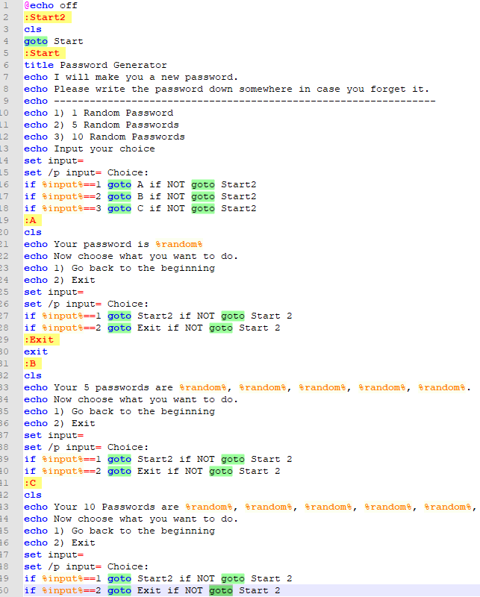

Slide 4

Some trivial examples to try . . .
C:\>td temp Navigates to the user’s temp directory in DOS.
C:\>of temp Opens the SAME folder as above except in Windows Explorer.
C:\>of Opens current DOS directory in Windows Explorer.
C:\>g s Show BitBucket status for current folder repositories INCLUDES online repository status comparison. I use this a lot.
C:\>c Clears the screen and resets the prompt color.

Slide 5
Scalable Self-Documenting Scripting
A cool thing about this architecture is that it is scalable in the sense that if you want some new script feature all you need to do is add a unique label and a code block and you are up and running.

Slide 6

To download and for more info., see:

